Slide 1
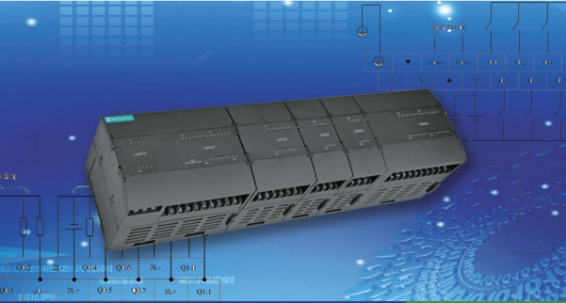
LE Series Programmable Logic Controller
LE Series PLC includes various kinds of CPU modules and expansion modules, and works with
powerful Auto Think Programming Software which has abundant instruction sets and functions
library. LE PLC is appreciated by its stable performance, reliable quality, convenient maintenance
and competitive price and has been applied widely in various industries of automation field.
LE series programmable logic controller (PLC) is a new generation high-performance micro PLC
offered by HollySys. This product fully takes the seamless integration of the system, controller, HMI
and software and the requirement for efficient coordination into consideration, and further improve
product’s portfolio.
Main features
  Compact design
  Simple and reliable installation
  Various module types
  Powerful analog processing
  Abundant instruction sets
  Special power-loss protection
  Off-line simulation
  IEC Standard programming languages
Application scenarios
  Punching machinery, printing machinery, textile machinery
  Construction machinery, packaging machinery, plastics machinery
  Motion control
  Environmental control equipment
  Central air conditioner
  Elevator control

Slide 2
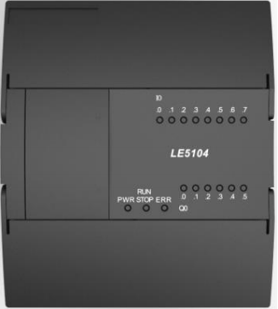
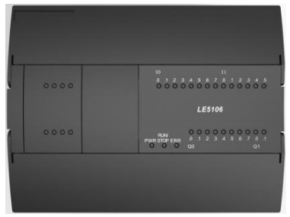
LE Series Programmable Logic Controller
14 points I/O CPU module, DC24V power supply, DI 8 × DC24V, DO 6 × transistor output
Model No. -LE5104
24 points I/O CPU module, DC24V power supply, DI 14 × DC24V, DO 10 × transistor output
Model No. LE5106

Slide 3
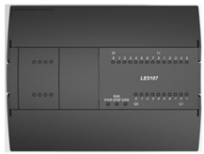
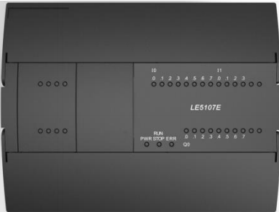
24 points I/O CPU module, AC230V power supply, DI 14 × DC24V, DO 10 × relay output
Model No. LE5107
24 points I/O CPU module, AC230V power supply, DI 12 × DC24V, DO 8 × relay output, 2×AI (4 ~ 20mA / 0 ~ 20mA / 0 ~ 10V), 2 × AO (4 ~ 20mA / 0 ~ 20mA / 0 ~ 10V
Model No. LE5107E

Slide 4
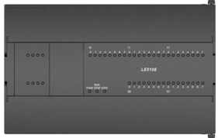
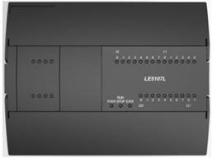
40 points I/O CPU module, DC24V power supply, DI 24 × DC24V, DO 16 × transistor output
Model No.LE5108
24 points I/O CPU module, AC230V power supply, DI 14 × DC24V, DO 10 × relay output, economy
Model No. LE5107L

Slide 5
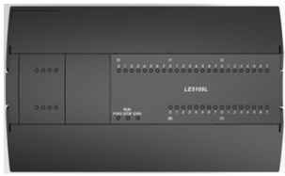
24 points I/O CPU module, AC230V power supply, DI 24 × DC24V, DO 16 × relay output, economy
Model No. LE5109L

Slide 6
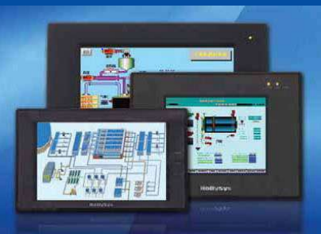
Human Machine Interface HMI Display Panel Product
HT Series HMI is a high-quality human machine interface product, integrating entirely CPU unit, input and
output unit, display, memory and other module units. It can be widely applied in industrial control systems
of all sectors of industry.
With the optimal design via hardware and software, it accords with requirements of machine control for
touch precision and accuracy, as well as for screen colors.
On the basis of the previous version, HT8001CN makes great improvements with a faster boot time,
higher page switching speed, higher communication speed, and higher sensitivity than before.

Slide 7
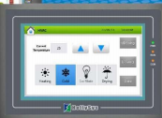
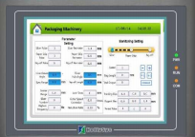
4.3 inches with 480×272 resolutions, 2.6 million color TFT, Memory 12M also Length width ratio 16:9 number of communication = 1, with USB A & USB B
Model No. - HT8421T
7.0 inches with 800×480 resolutions, 2.6 million color TFT, Memory 12M also Length width ratio 16:9 number of communication = 2, with RJ45 & USB A & USB B
Model No. -HT8701TE

Slide 8
7.0 inches with 800×480 resolutions, 2.6 million color TFT, Memory 12M also Length width ratio 16:9 number of communication = 2, with USB A & USB B
Model No. - HT8701T
7.0 inches with 800×480 resolutions, 2.6 million color TFT, Memory 12M also Length width ratio 16:9 number of communication = 1, with USB A & USB B
Model No. - HT8721T

Slide 9
10.2 inches with 1024×600 resolutions, 2.6 million color TFT, Memory 12M also Length width ratio 16:9 number of communication = 2, with RJ45 & USB A & USB B
Model No. - HT8A01TE
10.2 inches with 1024×600 resolutions, 2.6 million color TFT, Memory 12M also Length width ratio 16:9 number of communication = 2, with USB A & USB B
Model No. - HT8A01T

Slide 10
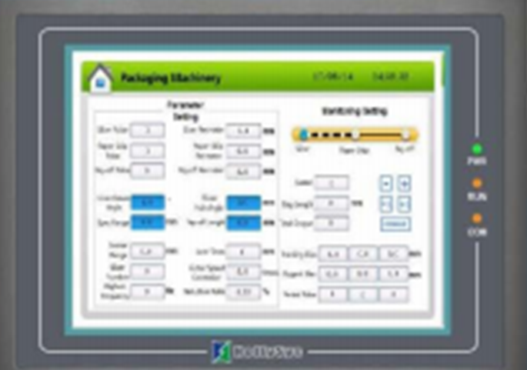
12.1 inches with 800×600 resolutions, 2.6 million color TFT, Memory 12M also Length width ratio 4:3 number of communication = 2, with RJ45 & USB A & USB B
Model No. -HT8C21T

